Slide 1

Department of Mechanical Engineering Indian Institute of Technology Tirupati
B. Tech Final Year Project Presentation
DESIGN AND FABRICATION OF EXPERIMENT FOR DYNAMIC ANALYSIS OF MECHANISMS
Aakash (ME16B001)
A. Akhil (ME16B003)
Supervised by
Dr. Sriram Sundar, Assistant Prof of ME
Date: 09-Dec-2019

Slide 2

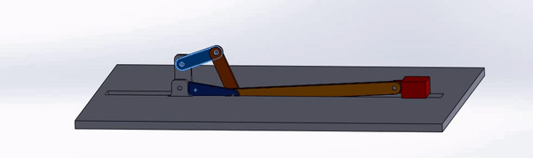
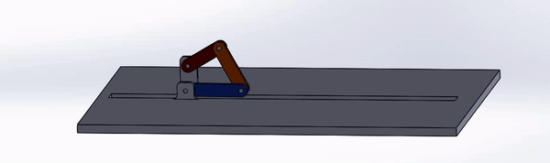
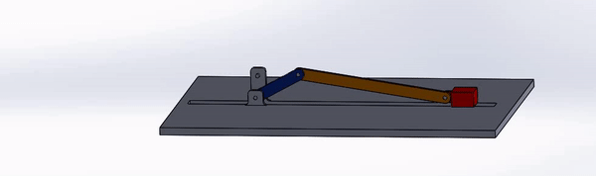
Objectives and Motivation
Dept. of Mechanical Engineering
B. Tech Final Year Project Presentation
Introduction - Design and fabrication of experimental setup for static, kinematic and dynamic analysis of mechanisms with retrofitted parts.
Motivation - The experiment will supplement and reinforce the theoretical understanding of the undergraduate students taking the ME2206 (KDM) course.
Six bar mechanism
Four bar mechanism
Slider crank mechanism
Notes:
by providing them the opportunity to match the analytical results with the actual experimental results.
to facilitate multiple experiments in the same setup.

Slide 3

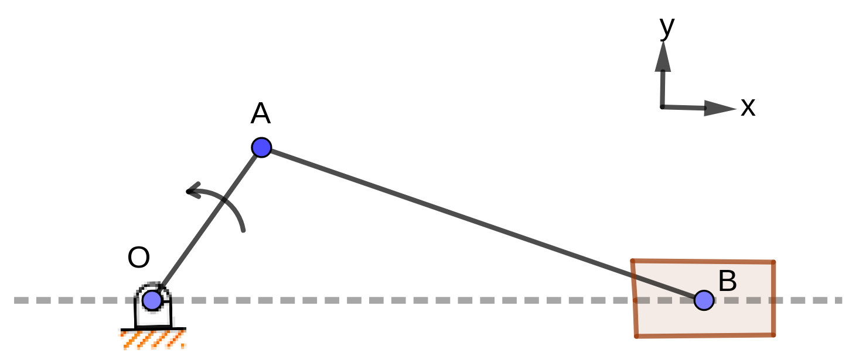
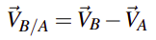
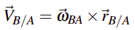
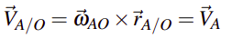
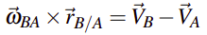
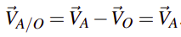
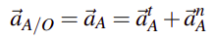
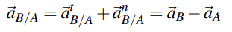
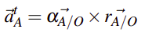
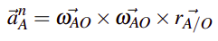
Mathematical Formulation
Dept. of Mechanical Engineering
B. Tech Final Year Project Presentation
Kinematics analysis
Finding angular velocity (AB) and slider velocity
Slider crank mechanism
Finding angular acceleration (AB) and slider acceleration
Note: there may be missing steps and common notations for the sake of brevity. Refer to report for completeness.

Slide 4
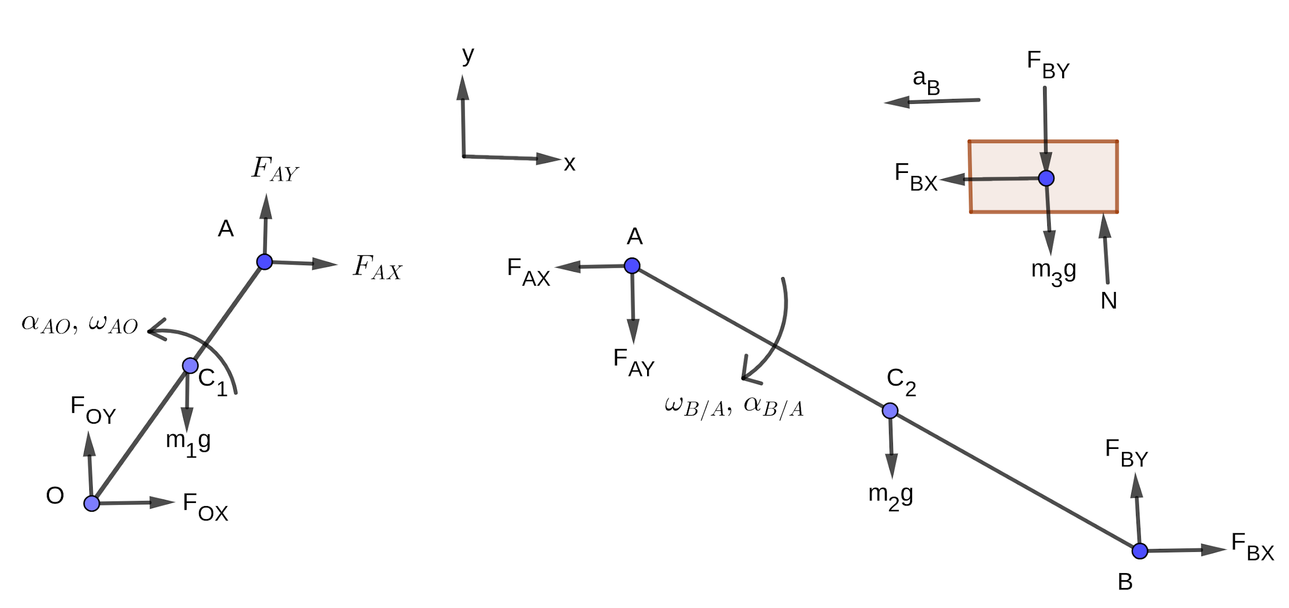
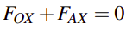
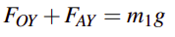
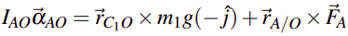
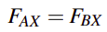
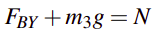
Mathematical Formulation
Dept. of Mechanical Engineering
B. Tech Final Year Project Presentation
Dynamic analysis
Force and torque balance for link OA
Slider crank mechanism
Force and torque balance for link AB
Force balance for slider
Note: there may be missing steps and common notations for the sake of brevity. Refer to report for completeness.

Slide 5
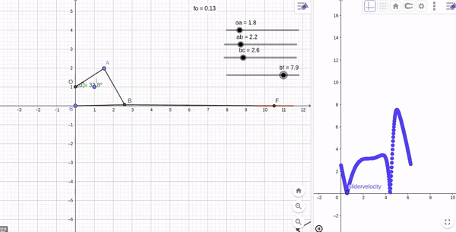
Kinematic Analysis
Dept. of Mechanical Engineering
B. Tech Final Year Project Presentation
By using Geogebra, we obtained preliminary link lengths and slider velocity profile.
Analysed the velocity profile by changing link lengths.

Slide 6
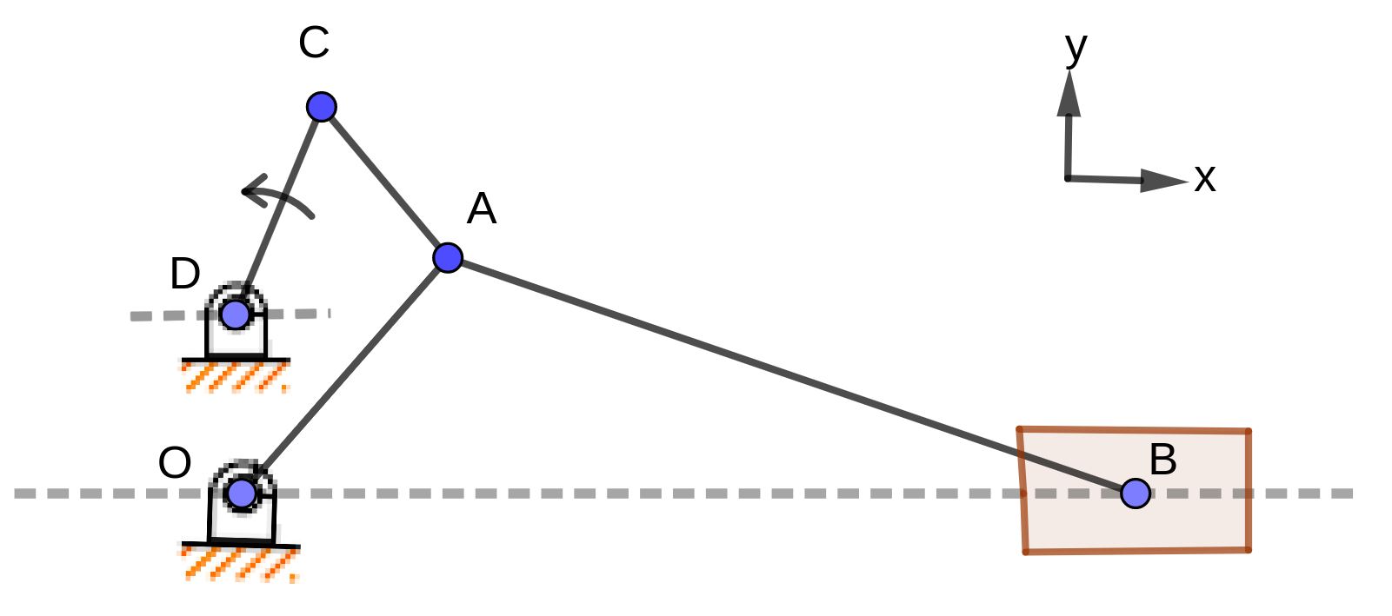
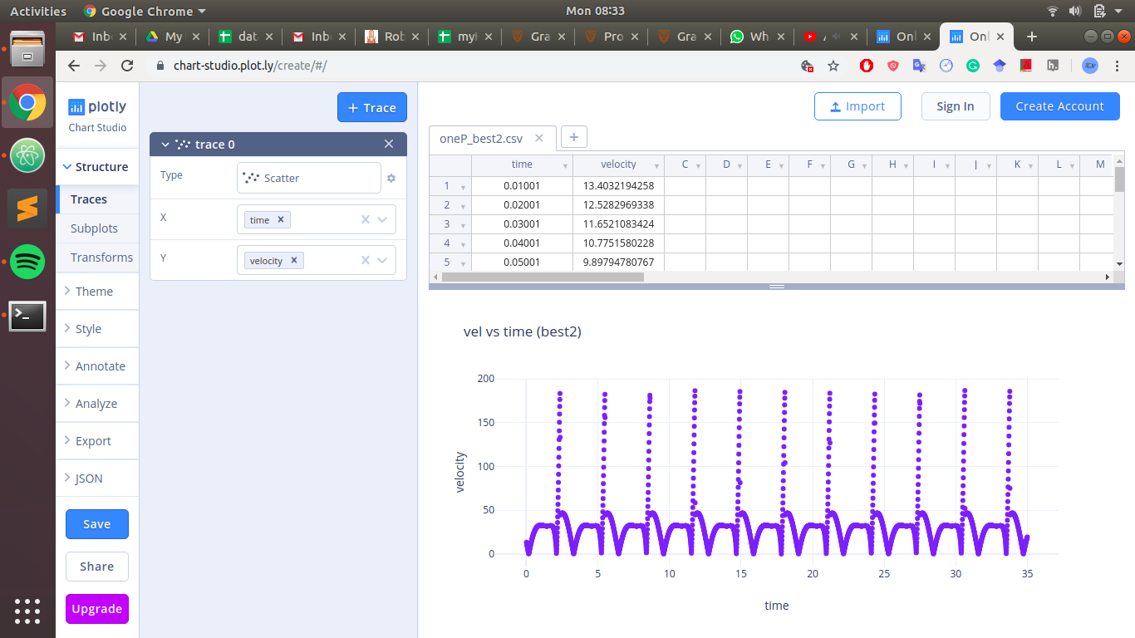
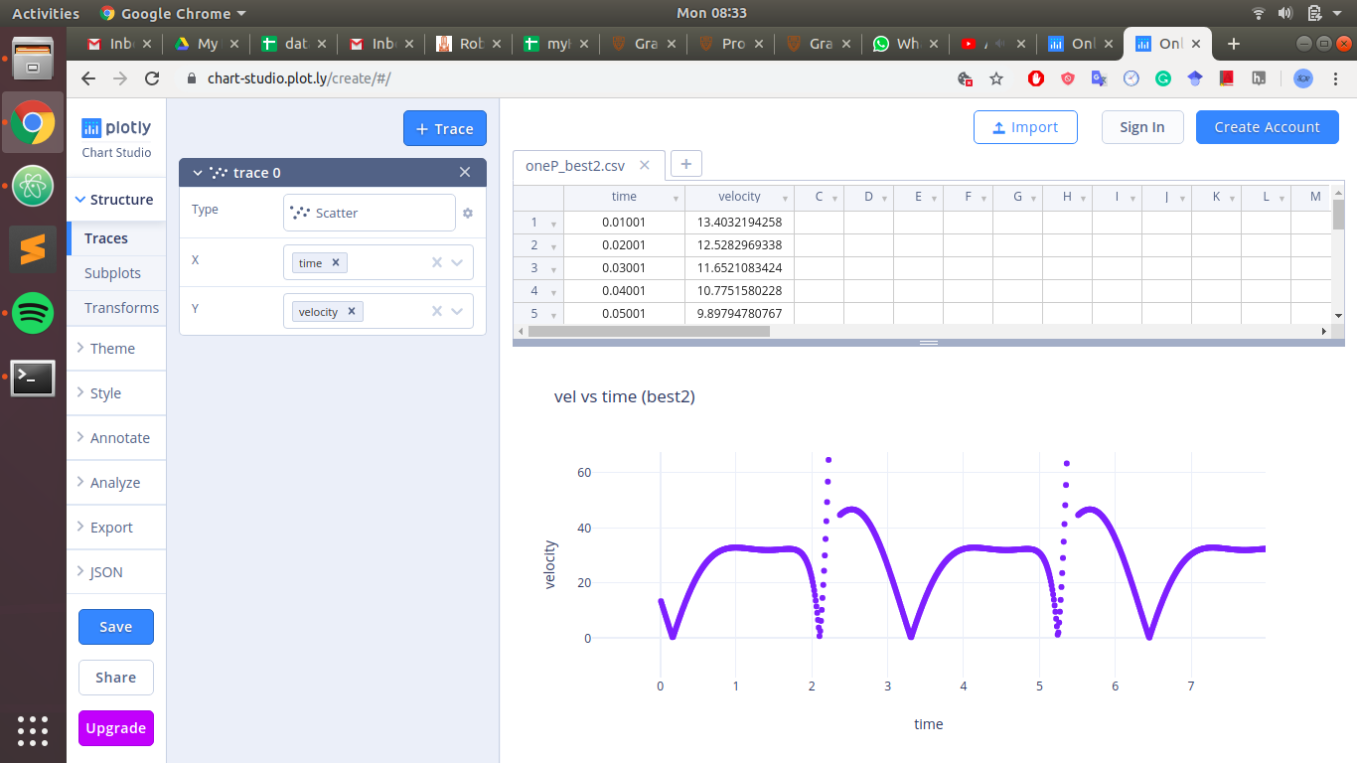
Design for constant velocity
Dept. of Mechanical Engineering
B. Tech Final Year Project Presentation
Iteration over preliminary length ratios obtained from GeoGebra
Obtained length ratios for minimal velocity variation
OA | AB | CD | AC
26 | 79 | 18 | 22
Velocity (unit/s) vs time

Slide 7
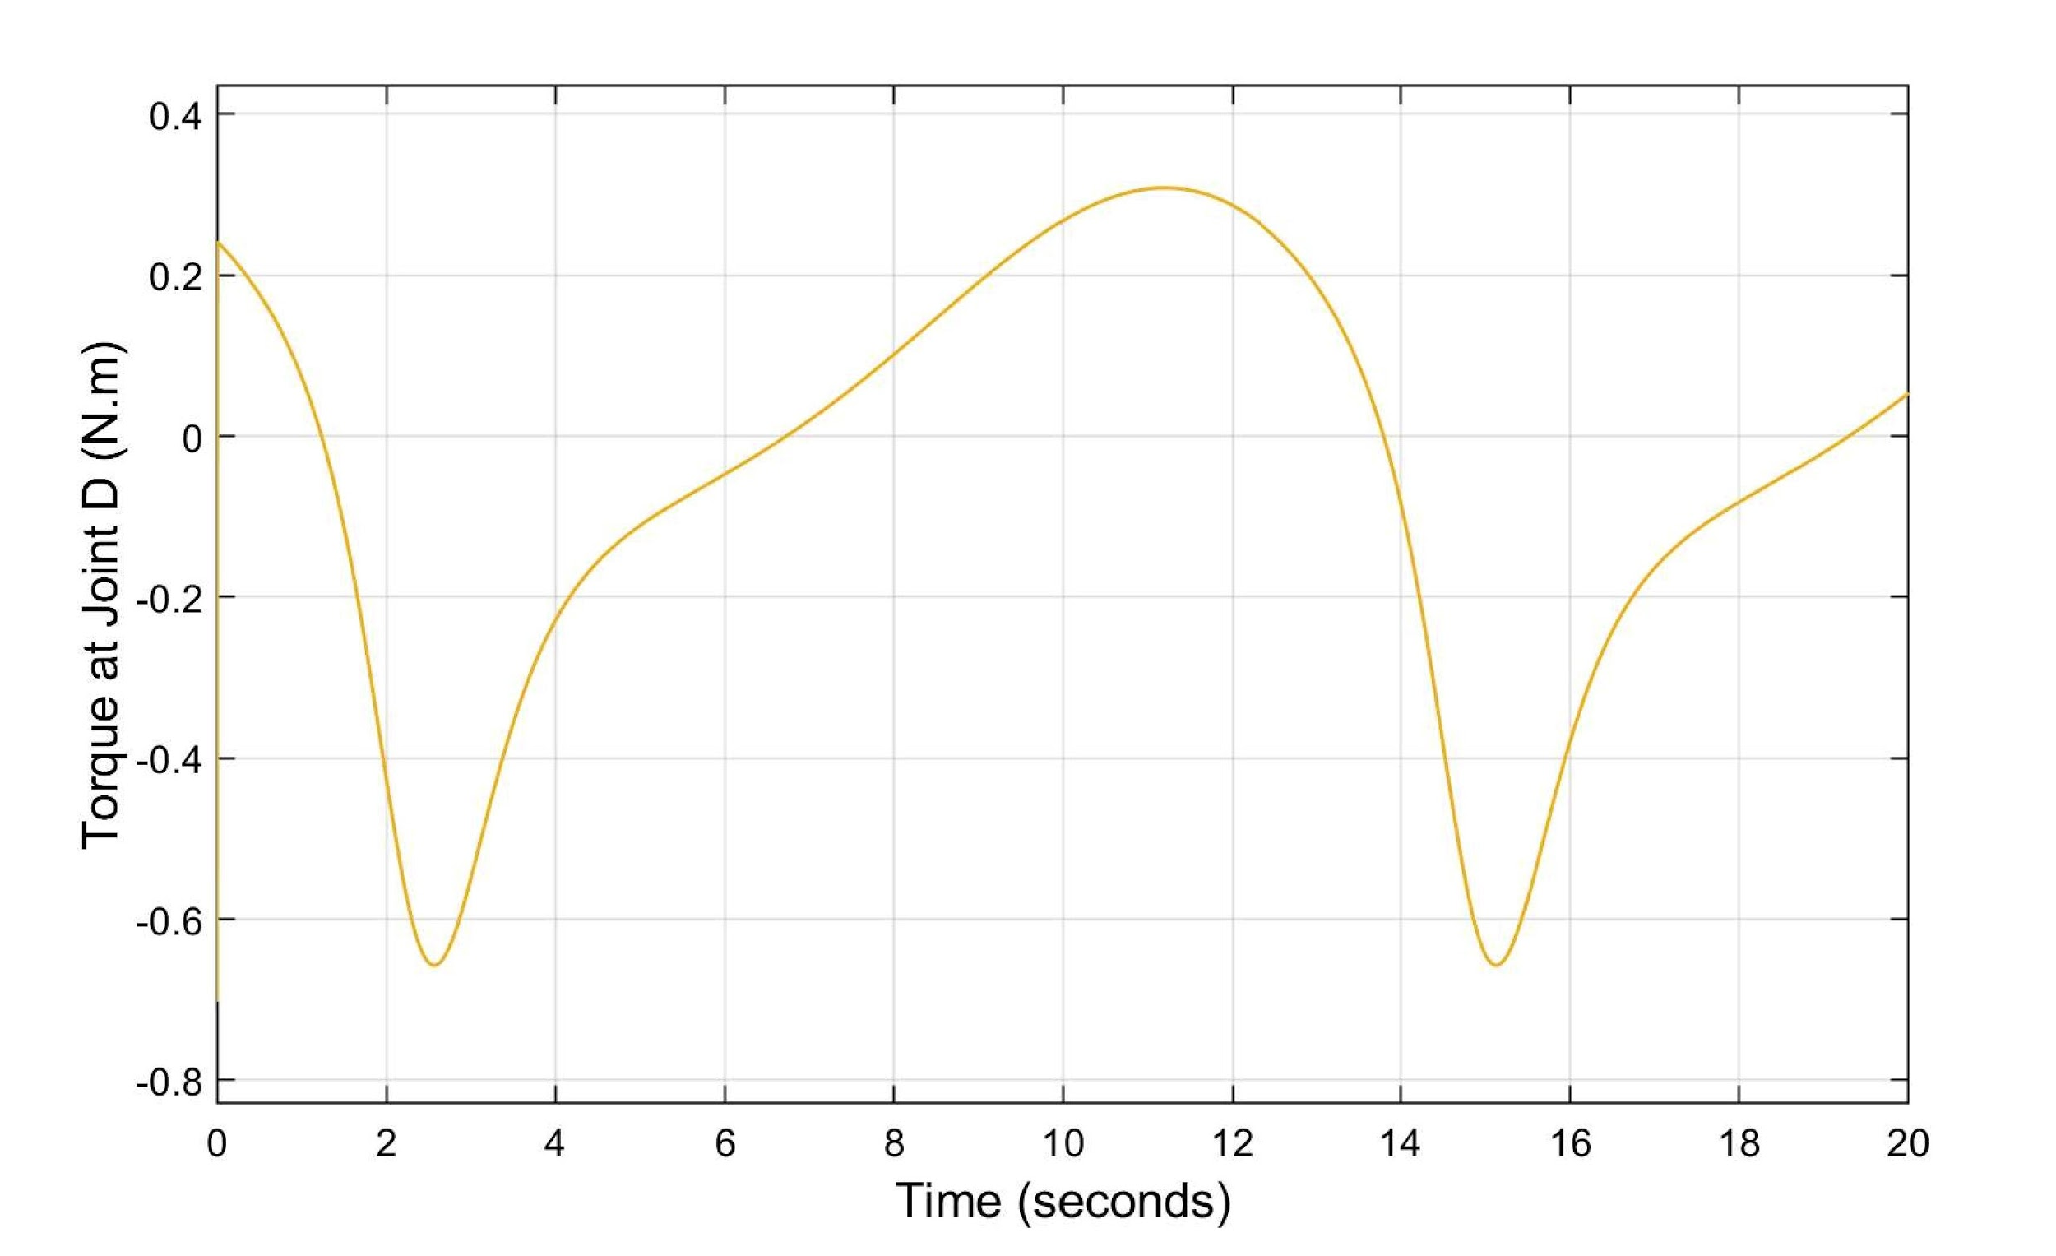
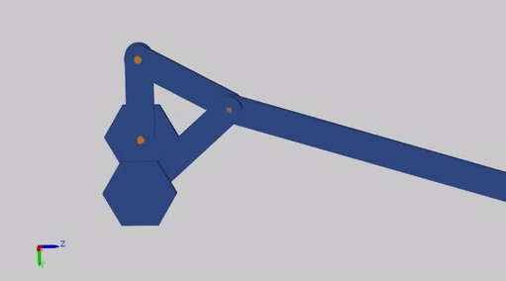
Dynamic Analysis
Dept. of Mechanical Engineering
B. Tech Final Year Project Presentation
Dynamic and kinematic analysis helps in designing mechanism which is suitable for taking measurements.

Slide 8
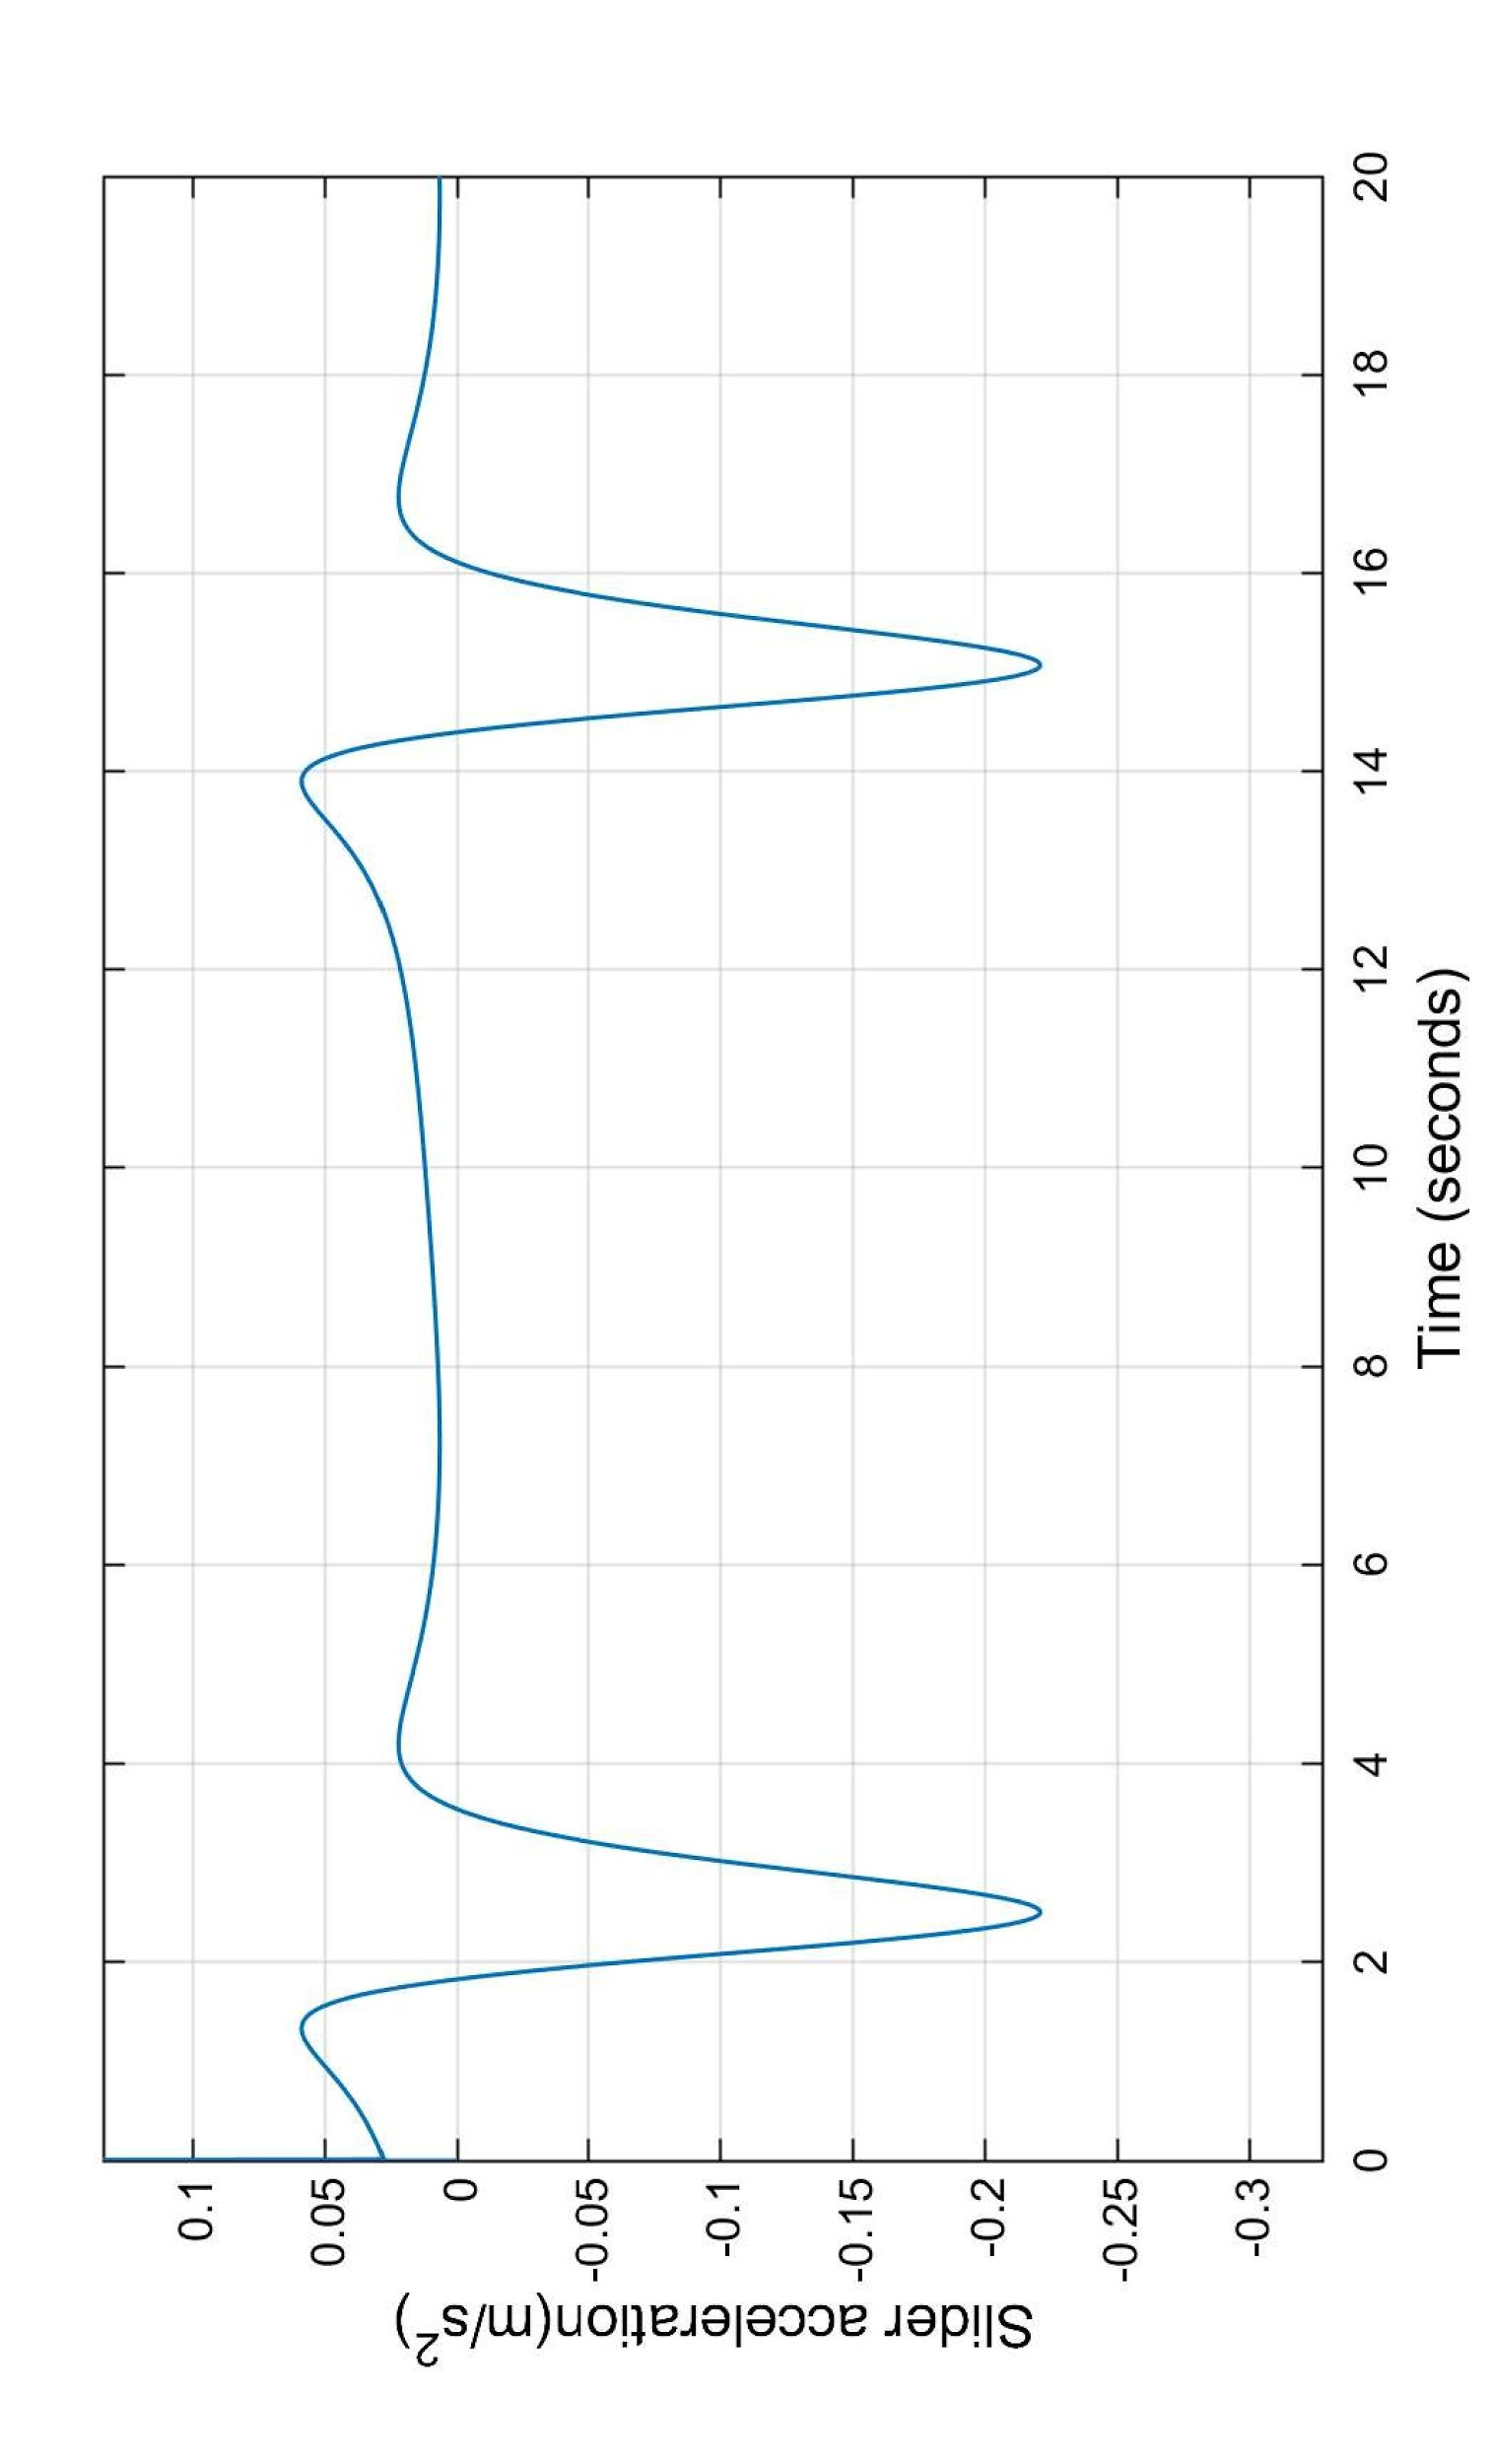
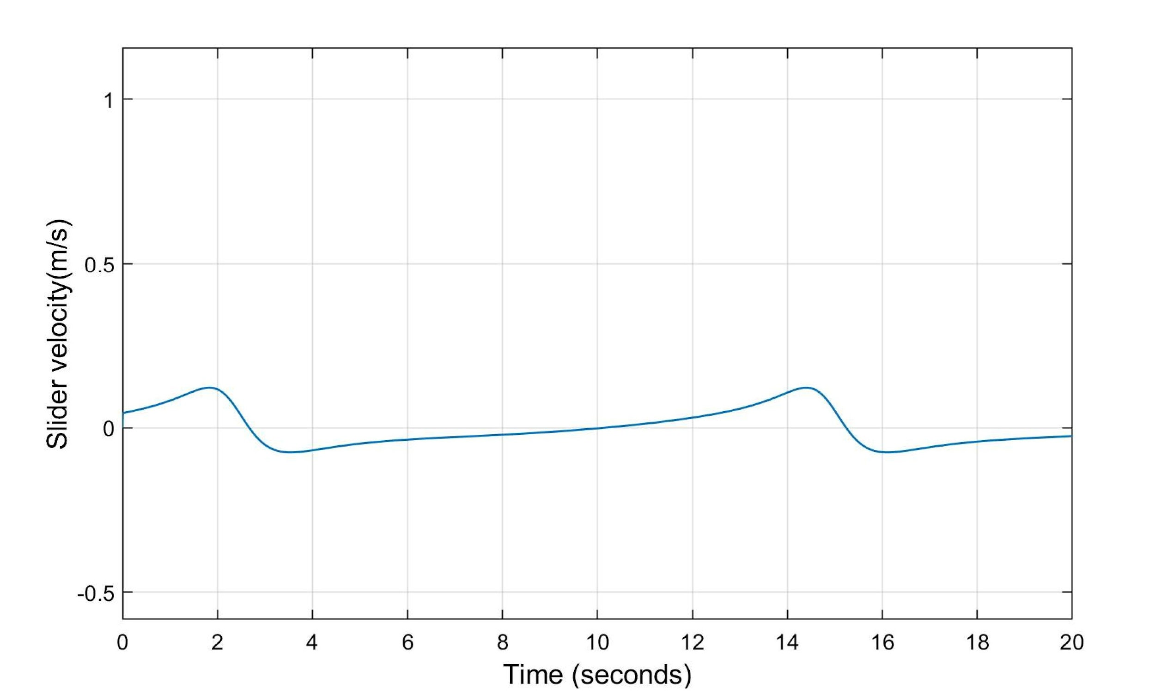
Results
Dept. of Mechanical Engineering
B. Tech Final Year Project Presentation

Slide 9
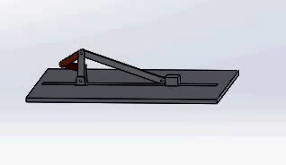
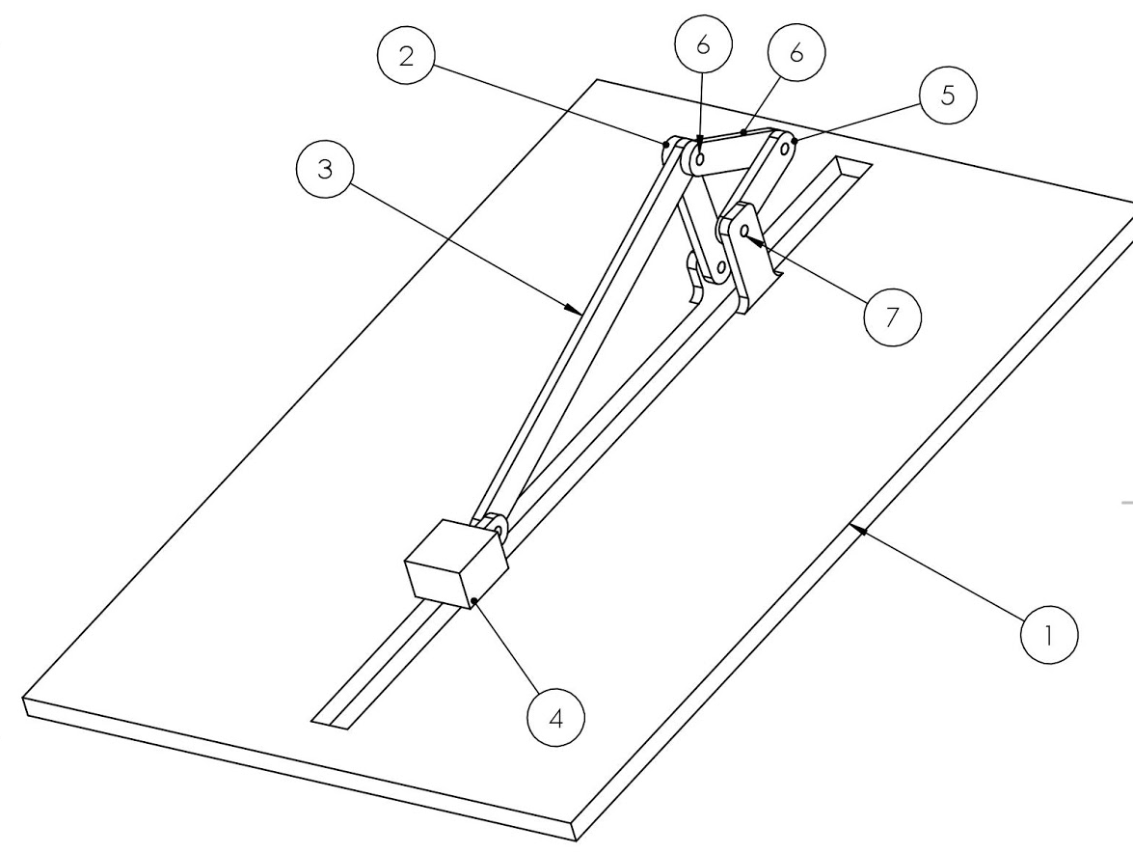
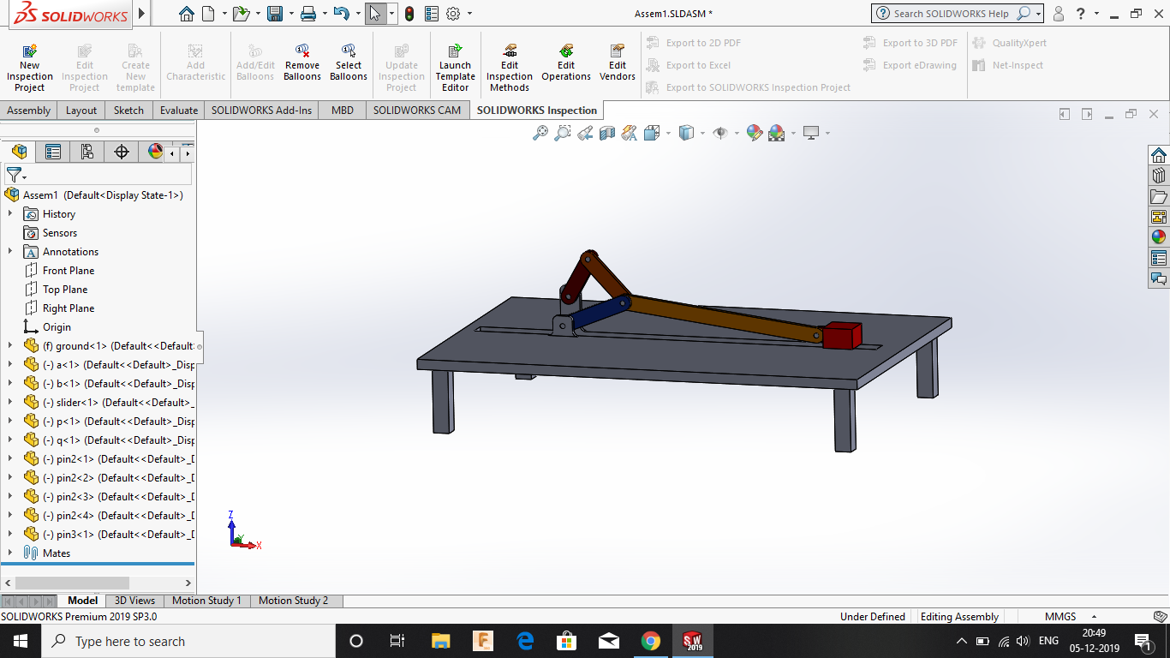
3D Model
Dept. of Mechanical Engineering
B. Tech Final Year Project Presentation
Part number | Part Name
1 | Ground
2 | Link OA
3 | Link AB
4 | Slider
5 | Link CD
6 | Link AC
The above models were rendered using SolidWorks

Slide 10

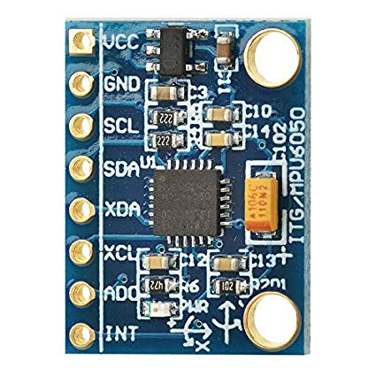
Sensor selection
Dept. of Mechanical Engineering
B. Tech Final Year Project Presentation
Based on the results obtained from kinematic and dynamic analysis using MathWorks Simscape, we selected the required sensors.
2-Phase Incremental Optical Rotary Encoder to detect angular velocity and angular acceleration of links
3-Axis Accelerometer is to detect linear acceleration and linear velocity of slider.
Source: robu.in
Source: amazon.in

Slide 11
Cost Analysis
Dept. of Mechanical Engineering
B. Tech Final Year Project Presentation
No | Name | Unit cost in INR | Quantity | Cost in INR
1 | Bearing | 50 | 20 | 1000
2 | Shoulder screw | 20 | 6 | 120
3 | Aluminum (for links and slider) | 200 per kg | 15kg | 3000
4 | Extruded Aluminum | 400 per m | 5 | 2000
5 | Actuator | - | - | -
6 | Rotary Encoder | 2000 | 3 | 6000
7 | Linear Accelerometer (8kHz) | 200 | 1 | 200
8 | Display | 1000 | 1 | 1000
9 | Other Electronics and miscellaneous |  |  | 5000
10 | Slotted weights, pulley | 2000 | 1 | 2000
 | Grand Total |  |  | 20,320/-
Note: tentative, minor changes may occur.

Slide 12
Experiment plan
Dept. of Mechanical Engineering
B. Tech Final Year Project Presentation
Aim:
1. To find the slider velocity and acceleration for six bar mechanism and slider crank mechanism
2. To find angular velocity and angular acceleration of all links in double crank mechanism.
Methodology and Results:
This experimental setup will store the data of all parameters for each angular position.
Students can select the angular position in the experimental setup to get the stored data display.
Students need to solve theoretically for any particular angular position of mechanism.
Students can compare theoretical results with practical results.

Slide 13
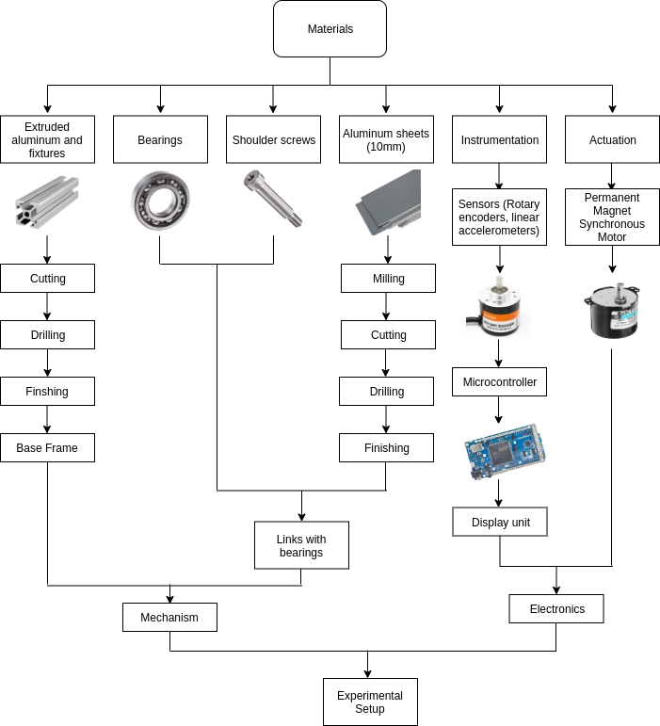
Manufacturing plan
Dept. of Mechanical Engineering
B. Tech Final Year Project Presentation
Sources: Bearing(SKF), Extruded Aluminum(indiamart.com), Shoulder screw(indiamart.com), AL sheets (indiamart.com)

Slide 14
Conclusions
Dept. of Mechanical Engineering
B. Tech Final Year Project Presentation
The complete analysis of the mechanism(s) was performed using applicable method and software.
3D CAD model of the mechanism was created to facilitate better visualisation.
Various design considerations were addressed and manufacturing workflow and plan were accomplished as a prerequisite to manufacturing.
BoM was prepared and materials acquisition from the vendor is in process.

Slide 15
Future Work
Dept. of Mechanical Engineering
B. Tech Final Year Project Presentation
Actuator selection
Final Design
Fabrication
Need to find the best actuator with its control system.
Final prototype model consisting of links, bearings, motors, sensors, etc.
Fabrication and assembling of links.
Experimentation, testing and validation.

Slide 16
References
Dept. of Mechanical Engineering
B. Tech Final Year Project Presentation
MATLAB version 9.3.0.713579 (R2017b). The Mathworks, Inc., Natick, Massachusetts, 2017.
A. Ghosh and A. K. Mallik, Theory of mechanisms and machines. Affiliated East-West Press Private Limited, 2002.
M. Hohenwarter, M. Borcherds, G. Ancsin, B. Bencze, M. Blossier, A. Delobelle, C. Denizet, J. Éliás, A. Fekete, L. Gál, Z. Konecný ˇ , Z. Kovács, S. Lizelfelner, B. Parisse, and G. Sturr (2013). GeoGebra 4.4. http://www.geogebra.org.
R. L. Norton, Kinematics and dynamics of machinery. McGraw-Hill Higher Education, 2011.
Python Core Team (2018). Python: A dynamic, open source programming language. Python Software Foundation. URL https://www.python.org/.
J. J. Uicker, G. R. Pennock, J. E. Shigley, et al., Theory of machines and mechanisms, volume 1. Oxford University Press New York, NY, 2011.

Slide 17
Acknowledgements
Dept. of Mechanical Engineering
B. Tech Final Year Project Presentation
Thanks to all those who helped us during the course of our B.Tech. project at IIT Tirupati. We are thankful to and fortunate enough to get constant encouragement, support and guidance from Dr. Sriram Sundar of Mechanical Engineering Department which helped us in successfully completing first phase of our project work. We would also like to extend our sincere esteems to all staff in laboratory for their timely support.
To our families, thank you for encouraging us in all of our pursuits and inspiring us to follow our dreams. We are especially grateful to our parents, who supported us emotionally and financially.

Slide 18
END

Slide 19
Supplementary material

Slide 20
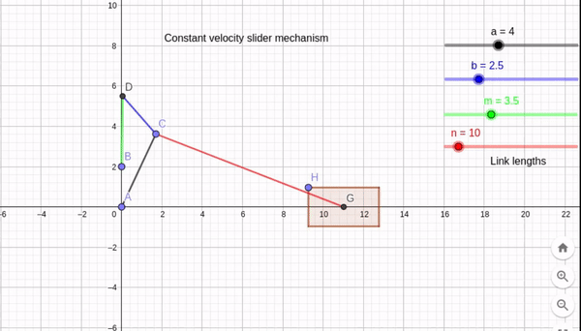
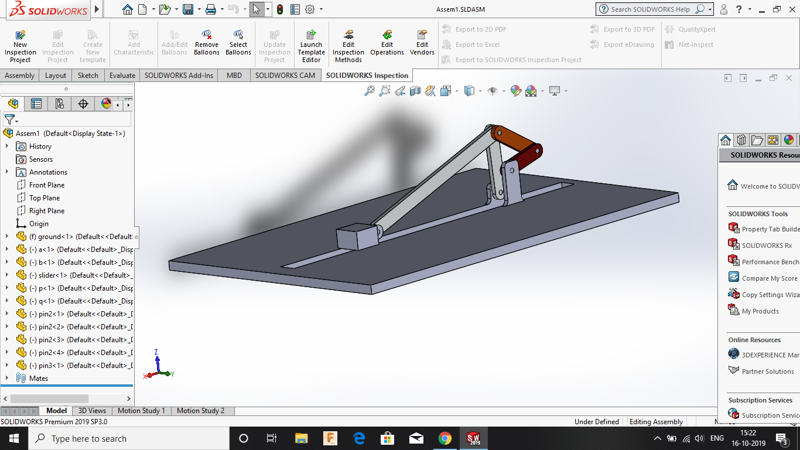
Updates
Dept. of Mechanical Engineering
B. Tech Final Year Project Presentation
GeoGebra
Python
Simscape
Sensors selection
Velocity (unit/s) vs time
Notes:
3D Modelling of the system with realistic dimensions to assist in fabrication and final designing.
Dynamic analysis of mechanism carried out in simscape(MATLAB).
Iterations were carried out in order to come up with a constant velocity mechanism having least variation
Preliminary kinematic analysis of mechanism.

Slide 21
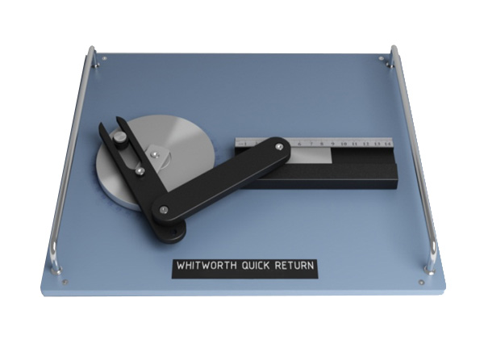
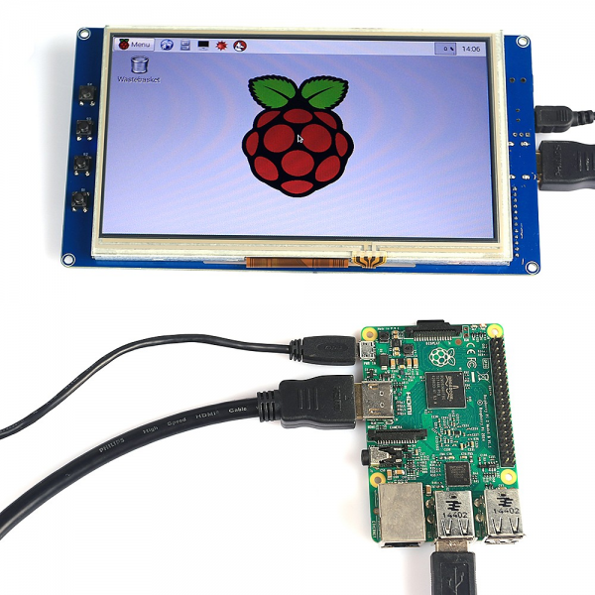
Introduction and Objectives
Dept. of Mechanical Engineering
B. Tech Final Year Project Presentation
To design and fabricate an experimental setup for static, kinematic and dynamic analysis of mechanism.
The setup will have retrofitted parts in order to let the student carry out multiple experiments in the same setup.
The experiment will supplement and reinforce the theoretical understanding of the undergraduate students taking the ME2206(KDM) by providing them the opportunity to match the analytical results with the actual experimental results.
source: ardubotics.com
source: sun labtech
Notes:
The field and/or area in which you will be working
(b) The aim and objectives of your work.
(c) The importance of your work and its applications

Slide 22
Plan
Dept. of Mechanical Engineering
B. Tech Final Year Project Presentation
Theoretical analysis
3D Modelling
Documentation
GeoGebra Modelling and sensor identification
Prototyping, Fabrication and Testing
Estimated budget : INR 25,000.00 - 30,000.00
Probable sensors for instrumentation: Rotary encoders, Ultrasonic range sensors, linear accelerometers, strain gauges

Slide 23
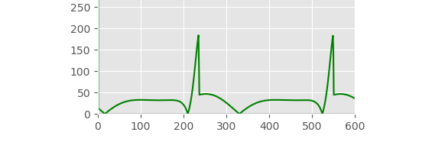
Literature Review
Dept. of Mechanical Engineering
B. Tech Final Year Project Presentation
Kinematics and Dynamics of Machinery, Robert L. Norton
Theory of Mechanisms and Machines, Ghosh and Mallik
Theory of Machines and Mechanisms, Uicker, Pennock and Shigley

Slide 24
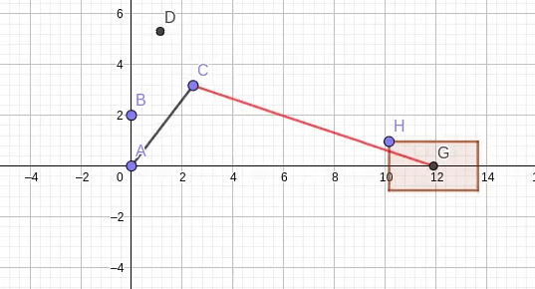
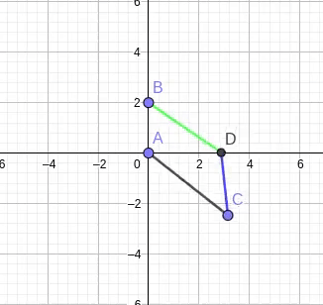
Mechanism
Dept. of Mechanical Engineering
B. Tech Final Year Project Presentation

